Slide 1
WELCOME

Slide 2
AuraAR
Team Members: -
Venkatesh Raichur – NEC0819066
Sangamesh Vakkar – NEC0819055
Mihir Kulkarni – NEC0819028
Salandar M – NEC0819071
Sanjay Maniruth – NEC0819057

Slide 3
AuraAR
Introduction
Augmented reality (AR)—a technology with enormous promise—is emerging as the key that will unlock the full potential of the Internet of Things (IoT).
AR applications are using the myriad kinds of data generated by IoT devices and components to help employees be more effective and productive.

Slide 4
AuraAR
Application

Slide 5
AuraAR
Application
Smart cities
Industrial and agricultural
Environmental monitoring
Smart buildings and smart homes
Hospitals

Slide 6
AuraAR
Motive

Slide 7
Motive
AuraAR
An attempt of making digital world more interactive by integrating Augmented Reality (AR) with IOT. Making it for real-time use with real-world objects.
It creates opportunities for teachers to help students grasp abstract concepts in interactive ways.

Slide 8
AuraAR
Advantages of AuraAR

Slide 9
Advantages of AuraAR
AuraAR
AR increases engagement and interaction and provides a richer user experience
IoT acts as a bridge between physical assets and digital infrastructure, while AR brings digital to life by interacting with the physical environment in real time

Slide 10
AuraAR
Hardware Requirements

Slide 11
AuraAR
Hardware Requirements
ESP32/Node MCU board
Relay (5v)
Hear-rate sensor
LED Bulb

Slide 12
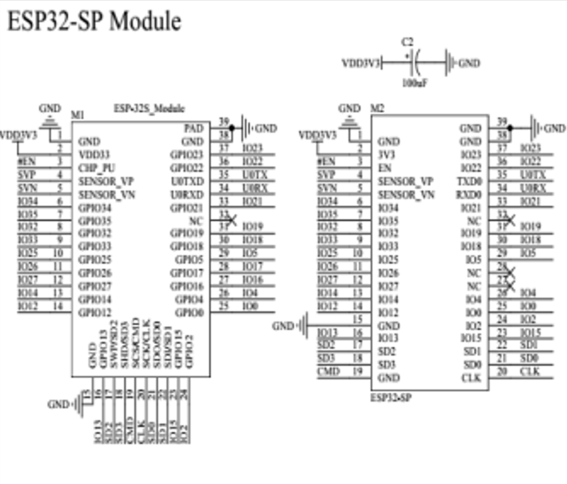
Relay (5v)
AuraAR
ESP32/Node MCU board
Node MCU development board based on ESP32, features WiFi+Bluetooth connectivity, onboard CH340 & keys.
Features: -
Onboard ESP32-S, CH340, USB to UART converter
2x19 pin extension headers, breakout all the I/O pins of modules
LED Bulb
Unity 3D software

Slide 13
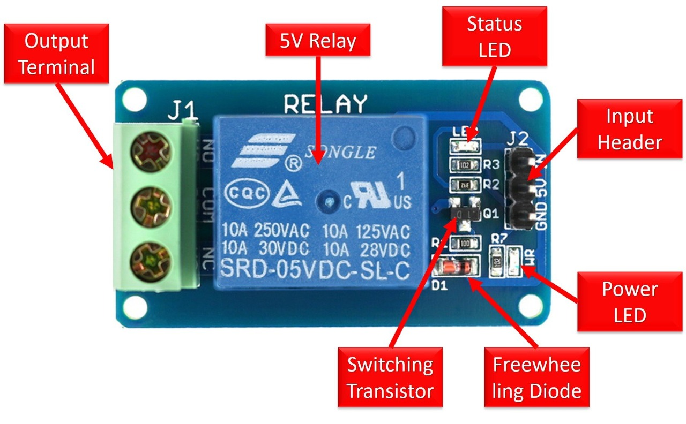
Hear-rate sensor
AuraAR
Relay (5v)
Normal Voltage is 5V DC Normal Current is 70mAAC load current Max is 10A at 250VAC or 125V ACDC load current Max is 10A at 30V DC or 28V DC.
It includes 5-pins & designed with plastic material.

Slide 14
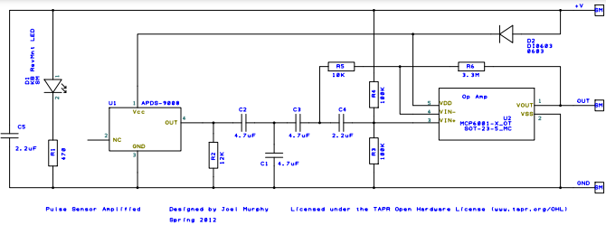
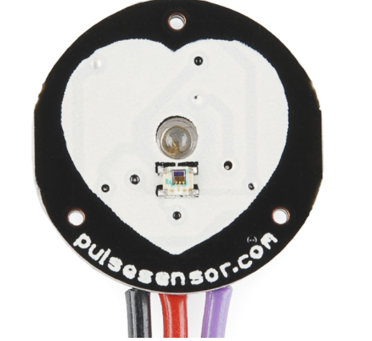
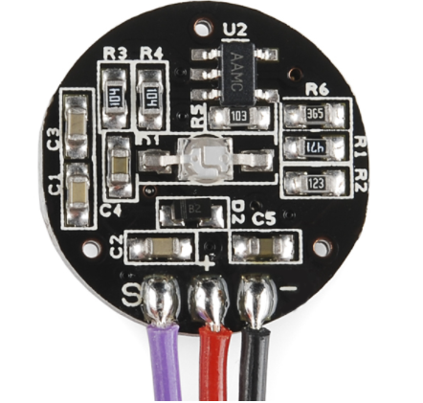
AuraAR
Hear-rate sensor
Heart rate data can be really useful whether you're designing an exercise routine, studying your activity or anxiety levels or just want your shirt to blink with your heart beat.
Heart-rate sensor
Schematic of heart-rate sensor

Slide 15
AuraAR
Software Requirements

Slide 16

AuraAR
Software Requirements
Unity 3D
Blynk IOT App
Vuforia 9.3.1
Embedded C Program
C-Sharp programming language

Slide 17
Unity 3D
AuraAR
Unity3D is a powerful cross-platform 3D engine and a user friendly development environment.
We can create 3D games and applications for mobile, desktop, the web, and consoles using Unity 3D software.

Slide 18
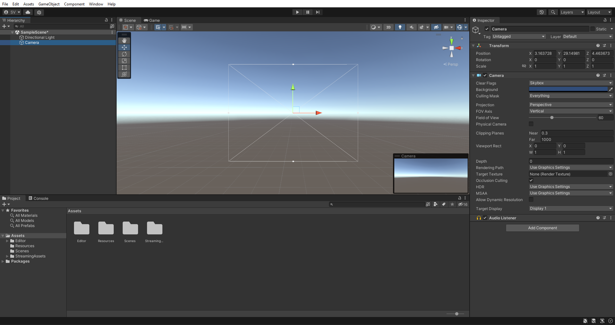
Unity 3D
AuraAR
Blynk IOT App
UI of Unity 3D software

Slide 19
Blynk IOT App
AuraAR
Blynk is an IoT platform for iOS or Android smartphones that is used to control Arduino, Raspberry Pi and Node-MCU via the Internet.
This application is used to create a graphical interface or human machine interface (HMI) by compiling and providing the appropriate address on the available widgets.

Slide 20
AuraAR
Modules

Slide 21
Modules
AuraAR
AR Button Controlled (LED)
AR Light Intensity
AR Heart-rate Monitoring
AR Light Color Switch

Slide 22
AuraAR
AR Button Controlled (LED)

Slide 23
AuraAR
AR Button Controlled (LED)
Requirements
Node MCU / ESP8266
Relay (5v)
LED Bulb
Unity 3D
Target Images

Slide 24
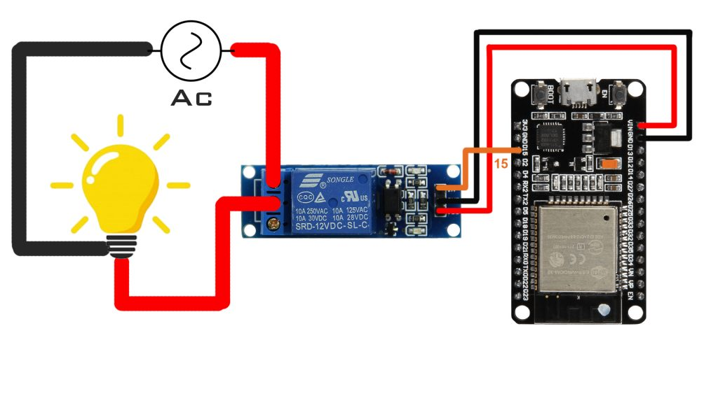
AuraAR
AR Button Controlled (LED)
Connection Diagram
Relay 5v
Node MCU /
ESP8266
LED Bulb

Slide 25
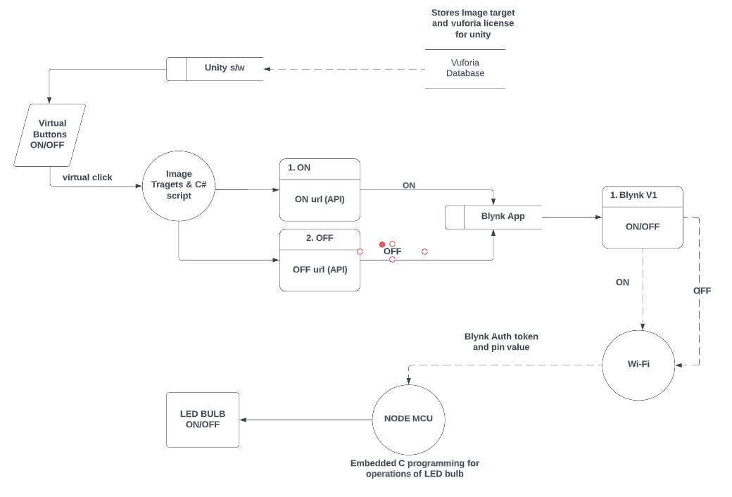
AuraAR
AR Button Controlled (LED)
System Flow Diagram of AR Button Controller

Slide 26
Thank You…

